Slide 1

Easy WebWorkers with Comlink
Bojan Bozinovski
Notes:
Hi everyone, my name is Bojan, I am JavaScript Lead at MELON and I have the honor to break the ice and open the presentations series for this conference. I am so happy that we are leaving the pandemic behind us and have the opportunity to gather and have such live events.

Slide 2
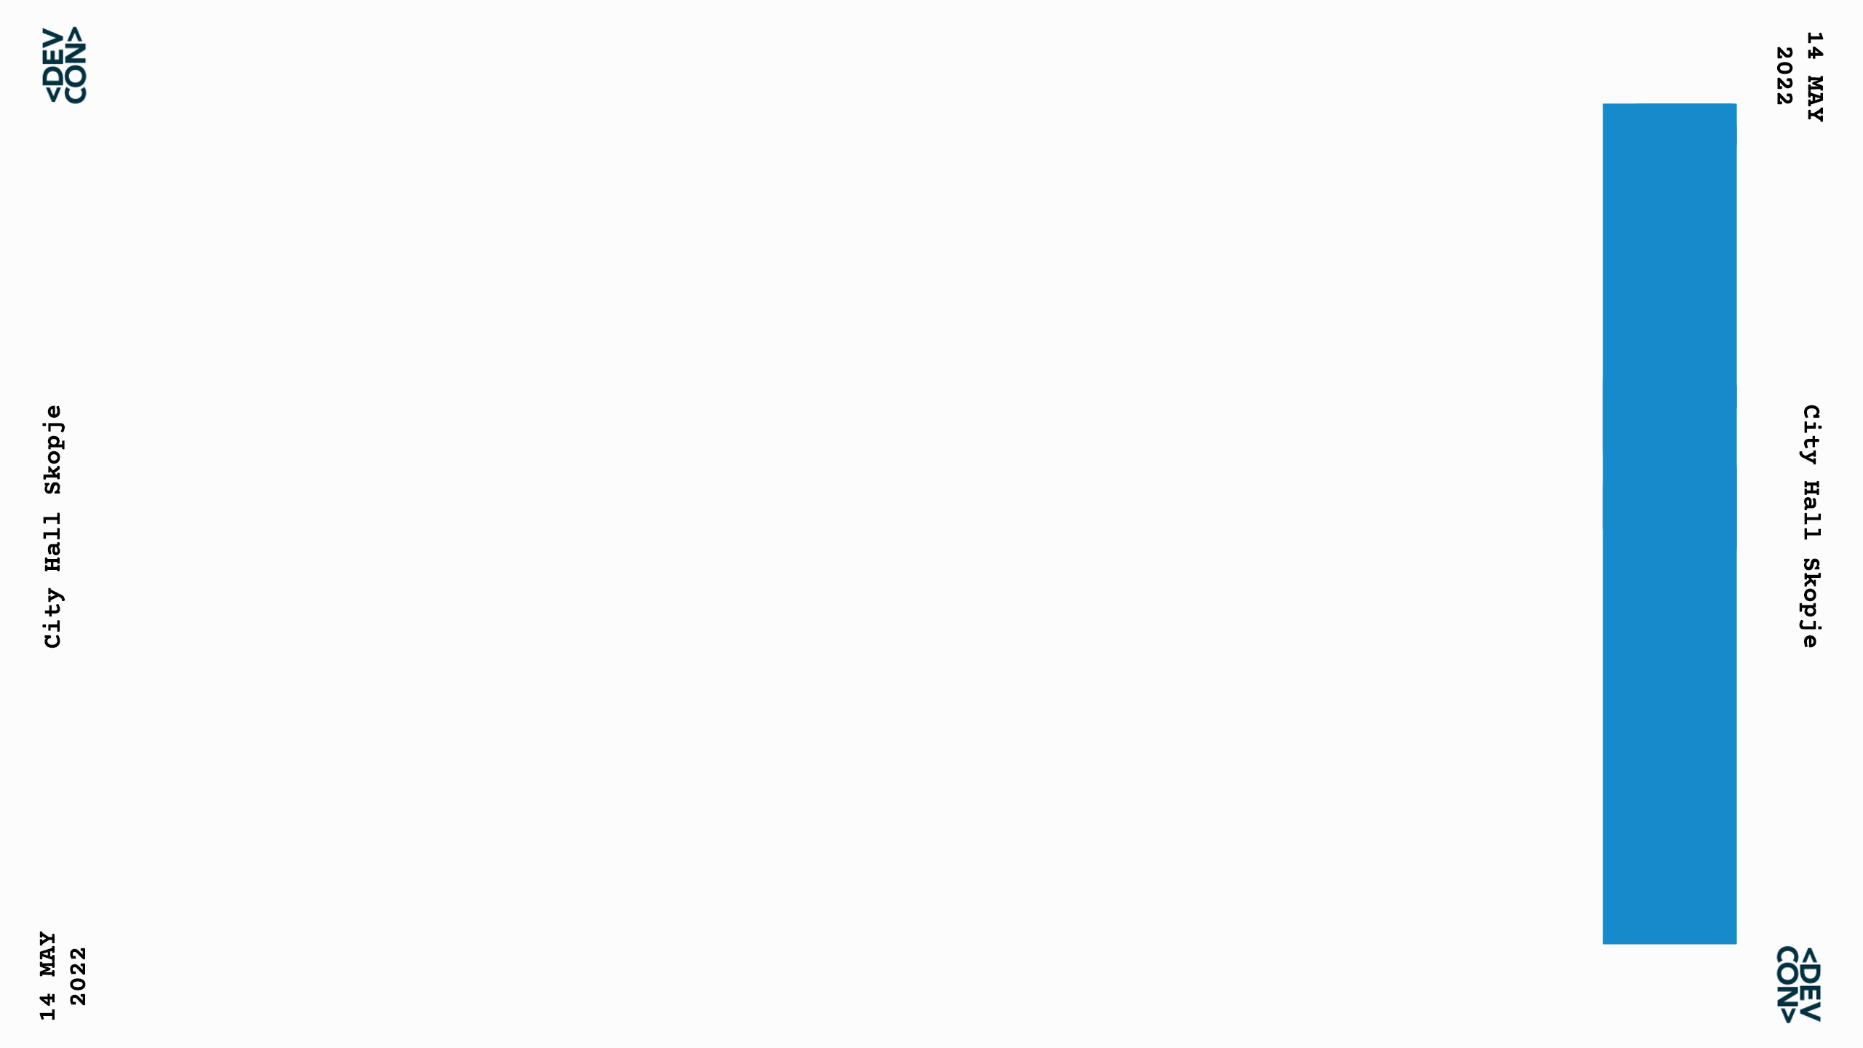


PHOTO BOX
Bojan Bozinovski
JavaScript Lead @melon
bbojan @github
bb0jan @Instagram
bb0jan @twitter
Notes:
Hi everyone, my name is Bojan, I am JavaScript Lead at MELON and I have the honor to break the ice and open the presentations series for this conference. I am so happy that we are leaving the pandemic behind us and have the opportunity to gather and have such live events.

Slide 3

JavaScript is single-threaded.
Incorrect!
We can off-load work on background threads with WebWorkers
Even a single worker can give the main thread some much needed breathing room
Web Workers are under utilized because they’re frustrating to manage.
How do you communicate with a worker? Messages.

Slide 4

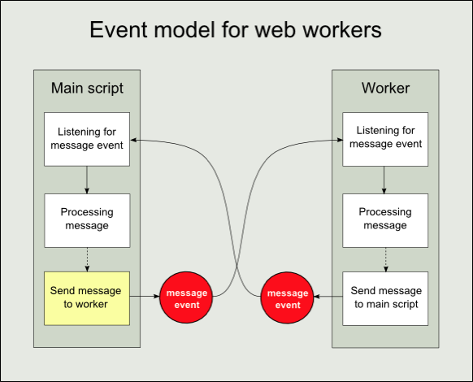

Slide 5
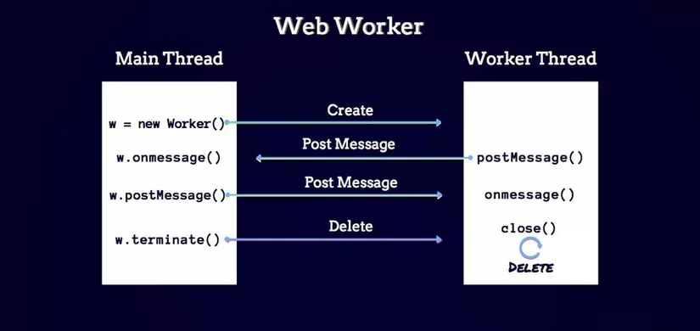

Slide 6
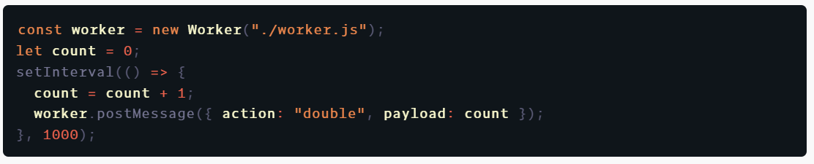
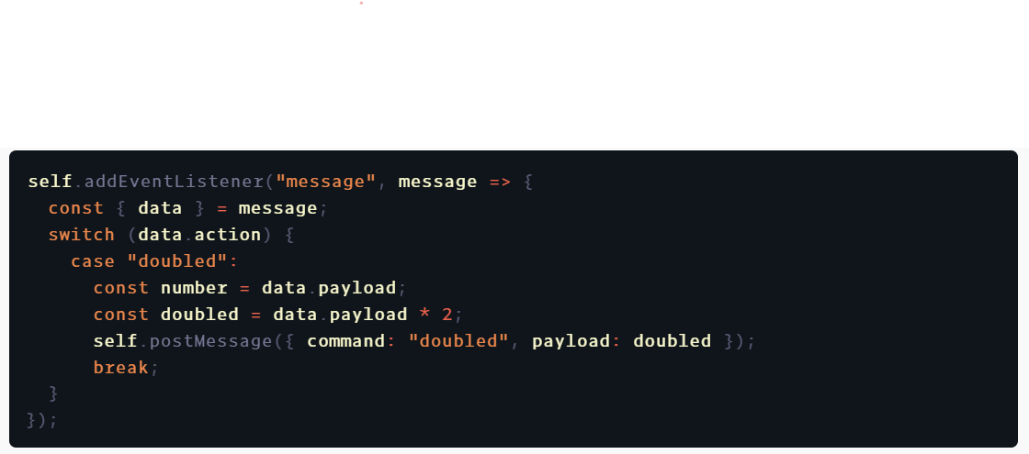

Slide 7
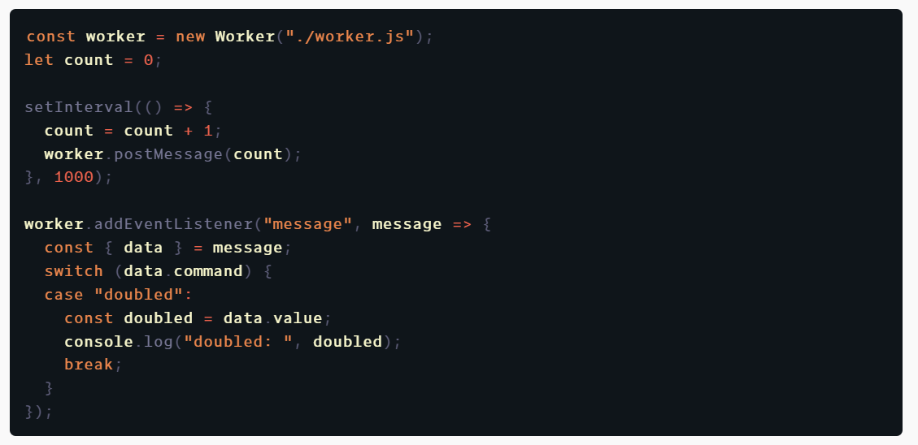

Slide 8

https://github.com/GoogleChromeLabs/comlink
Comlink is Remote Procedure Call (RPC) library for workers
Comlink makes WebWorkers enjoyable.
It removes the mental barrier of thinking about postMessage and hides the fact that you are working with workers.

Slide 9
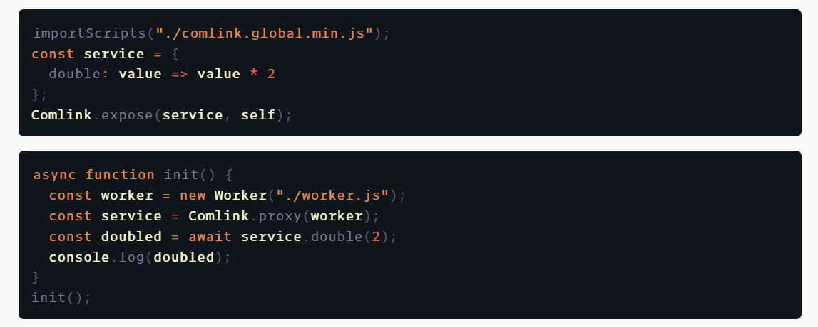

Slide 10
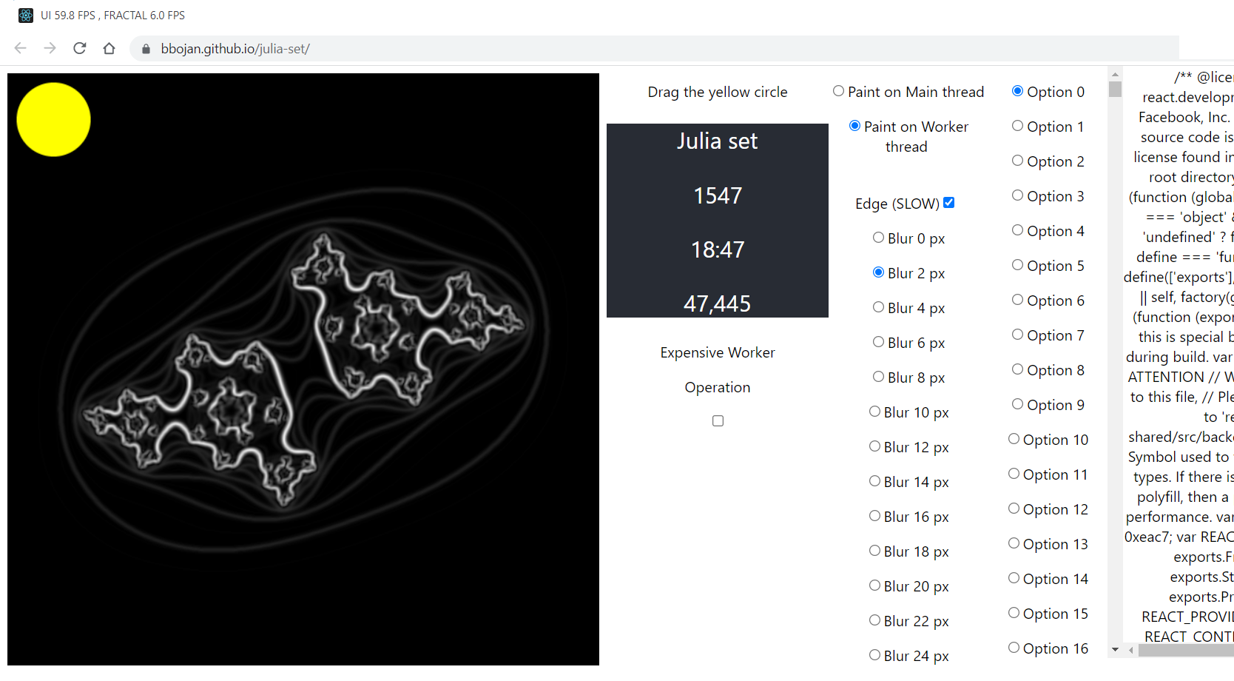
DEMO

Slide 11
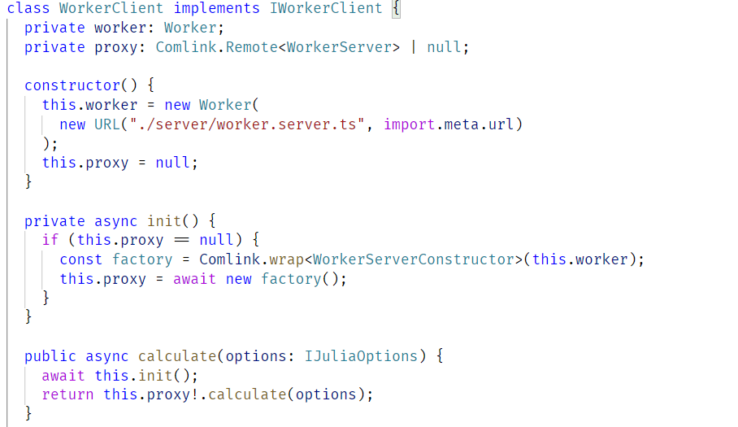
Webpack 5
As of webpack 5, you can use Web Workers without worker-loader.

Slide 12
Webpack 4
In Webpack 4 we needed to use comlink-loader
declare module "comlink-loader!*" {
// import WorkerServer from "comlink-loader!./worker.server"; // inline loader
export default WorkerServer;

Slide 13
Takeaways
The main thread should be free for UI interactions, animations,
That will guarantee better User Experience
Any heavy calculations should be off-loaded in background, or on the server.

Slide 14
Questions ?
Demo
http://bbojan.github.io/julia-set
Source code
https://github.com/bbojan/julia-set

Slide 15
Thank you!
bbojan @github

